Slide 1



fullstackdatascience.com
Basic SQL
When asked for advice for data scientists, the father of Python responded, "Learn SQL."
Created by HuyNT
DA K6
Lesson 2
huynt@fullstackdatascience.com
1

Slide 2

Learn
About
01/
SQL Basics
02/
Data types
03/
Sorting and Filtering Results
04/
Practice Session
fullstackdatascience.com
2

Slide 3
SQL Basics
What is SQL?
Types of SQL statement
Select - From Clause
3

Slide 4


Introduction to SQL
1. What is SQL?
SQL (Structured Query Language) is a language used to manage and manipulate data in relational database management systems (RDBMS).
It is used for querying, updating, inserting, and deleting data.
2. History of SQL
SQL was developed in the 1970s by IBM as part of the System R project.
In 1974, Donald D. Chamberlin and Raymond F. Boyce designed SEQUEL (Structured English Query Language), the predecessor of modern SQL.
In 1979, Oracle (then known as Relational Software, Inc.) released the first commercial version of SQL.
In 1986, SQL was standardized by ANSI (American National Standards Institute) and has since evolved through versions such as SQL-89, SQL-92, SQL:1999, SQL:2003, SQL:2011, and newer updates.
Today, SQL is the standard language for relational database management systems like MySQL, PostgreSQL, SQL Server, Oracle, etc.
4

Slide 5
DDL - Data Definition Language
Statement | Purpose | Object
 |  | database | table | column | Index | View | Procedure | Function | Trigger | Schema | User
CREATE | Define | X | X |  | X | X | X | X | X | X | X
ALTER | Modify |  | X | X | X | X | X | X | X | X | X
DROP | Permanently remove | X | X |  | X | X | X | X | X | X | X
TRUNCATE | Remove records |  | X
RENAME | Change name |  | X | X | X | X | X | X | X
4

Slide 6
DML - Data Manipulation Language
Statement | Object | Purpose | Object
 |  |  | database | table | column | Index | View | Procedure | Function | Trigger | Schema | User
INSERT | Rows | Define | X | X |  | X | X | X | X | X | X | X
UPDATE |  | Modify |  | X | X | X | X | X | X | X | X | X
DELETE |  | Permanently remove | X | X |  | X | X | X | X | X | X | X
MERGE | INSERT, UPDATE, DELETE clauses | Remove records |  | X
4

Slide 7
DQL - Data Query Language
Structure of a simple DQL statement
1 | SELECT [DISTINCT] col1, col2, …
2 | FROM table_name
3 | [JOIN table_2 ON join_condition]
4 | [WHERE condition]
5 | [GROUP BY col1, col2, …]
6 | [HAVING condition]
7 | [QUALIFY condition]
8 | [ORDER BY col1 [ASC|DESC], col2 [ASC|DESC], …]
9 | [LIMIT number OFFSET offset]
\
4
Notes:
Nợ giải thích về left, right, outer, inner

Slide 8
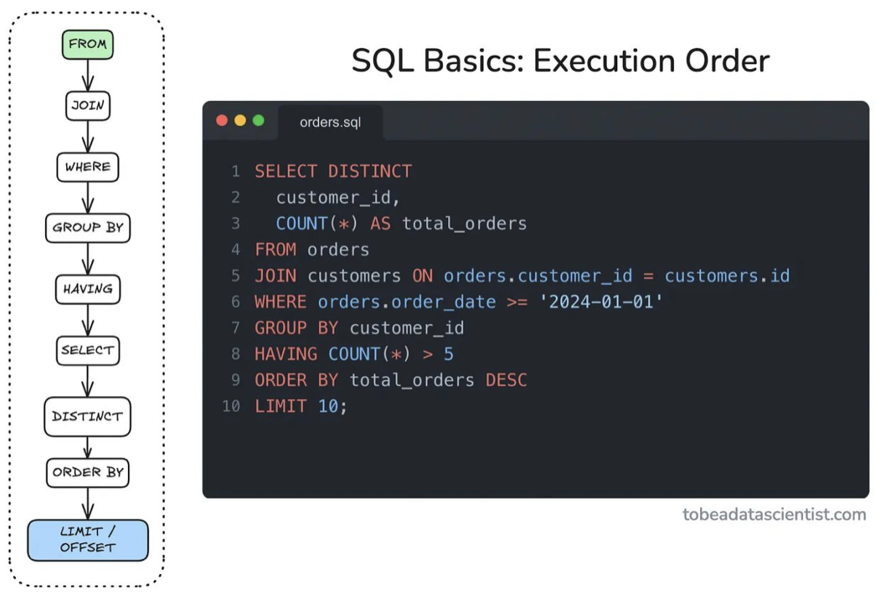
Execution Order
\
4

Slide 9
SELECT Clause
Purpose: Specifies the columns or expressions to retrieve from the database
Position in the query: The beginning of all DQL statements
Basic syntax:
SELECT
[ALL | DISTINCT] column_list
FROM table_name
Column_list: list of columns, expression, or aggregate function
ALL (default): returns all matching rows, including duplicates
DISTINCT: de-duplicate all rows
Other topics:
column alias
SELECT *
column selection convention
5

Slide 10
FROM Clause
Purpose: Specifies the table or view to query from
Position in the query: following the SELECT clause
Basic syntax:
SELECT
[ALL | DISTINCT] column_list
FROM table_name [alias]
table_name: The name of the table or view
alias: optional alternative name for the table within the query
5

Slide 11
Data
Types
Strings
Numbers
Date Time
Null Value
3

Slide 12
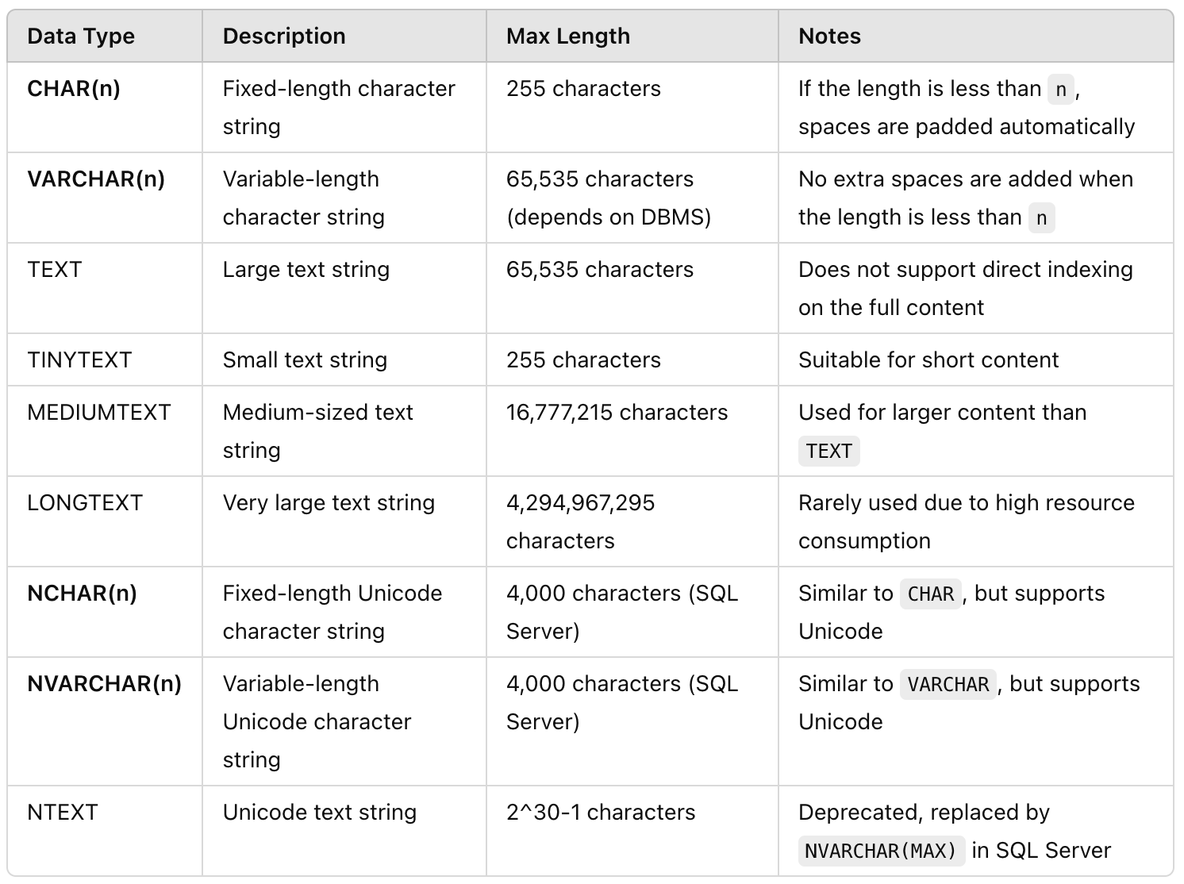
Strings
5

Slide 13
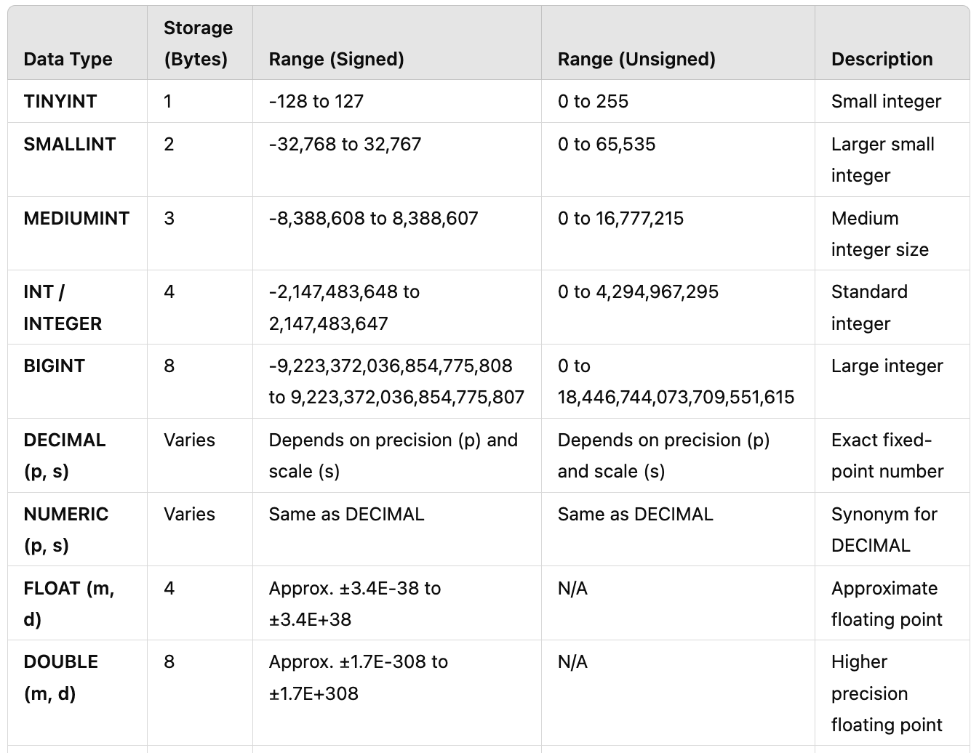
Numbers
5

Slide 14
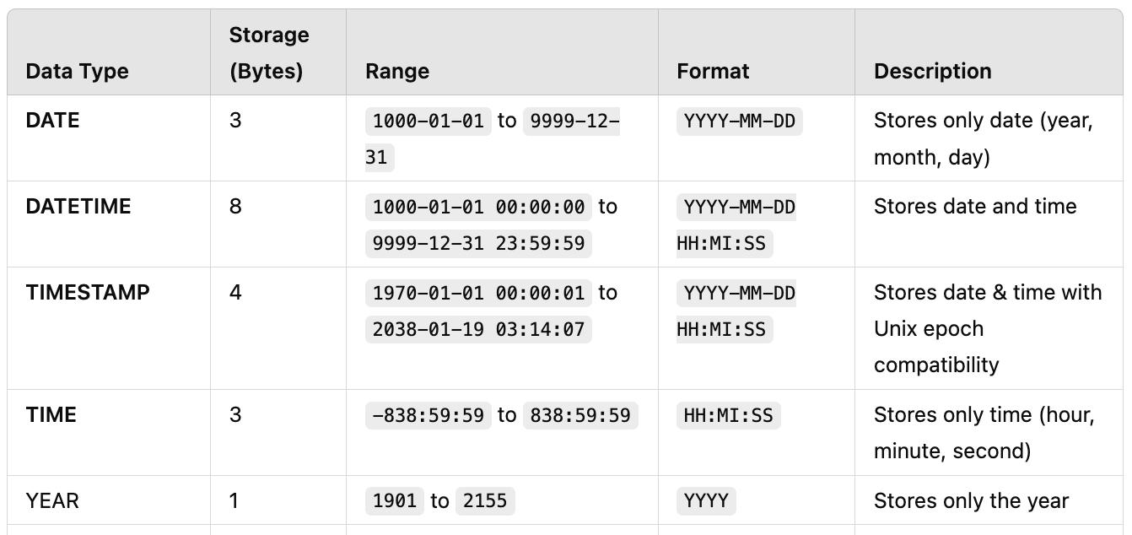
Date Time
5

Slide 15



Null Value
1. Definition of NULL in SQL
NULL in SQL represents missing or unknown data.
NULL is not the same as 0 or an empty string ('').
When a value is NULL, it means the value does not exist or is not defined.
2. Characteristics of NULL in SQL
Any operation involving NULL (NULL + 5, NULL * 10) results in NULL.
Use IS NULL instead of = NULL
3. Handling NULL in SQL
SELECT COALESCE(price, 0) AS final_price FROM products;
SELECT IFNULL(discount, 0) FROM sales;
5

Slide 16
Common Functions
Strings
Function | Description | Example
LENGTH(str) | Returns the length of a string | LENGTH('hello') → 5
UPPER(str) | Converts string to uppercase | UPPER('hello') → 'HELLO'
LOWER(str) | Converts string to lowercase | LOWER('HELLO') → 'hello'
TRIM(str) | Removes leading and trailing spaces | TRIM(' hello ') → 'hello'
LTRIM(str) | Removes leading spaces | LTRIM(' hello') → 'hello'
RTRIM(str) | Removes trailing spaces | RTRIM('hello ') → 'hello'
SUBSTRING(str, start, length) | Extracts a substring | SUBSTRING('hello', 2, 3) → 'ell'
LEFT(str, length) | Extracts the left part of a string | LEFT('hello', 2) → 'he'
RIGHT(str, length) | Extracts the right part of a string | RIGHT('hello', 2) → 'lo'
REPLACE(str, old, new) | Replaces part of a string | REPLACE('hello', 'l', 'x') → 'hexxo'
CONCAT(str1, str2, ...) | Concatenates strings | CONCAT('hello', ' ', 'world') → 'hello world'
POSITION(substr IN str) | Finds the position of a substring | POSITION('l' IN 'hello') → 3
INSTR(str, substr) | Finds the position of a substring | INSTR('hello', 'l') → 3
REVERSE(str) | Reverses a string | REVERSE('hello') → 'olleh'
5

Slide 17
Common Functions
Numbers
Function | Description | Example
ABS(num) | Returns the absolute value | ABS(-10) → 10
ROUND(num, decimals) | Rounds a number | ROUND(3.14159, 2) → 3.14
CEIL(num) | Rounds up to the nearest integer | CEIL(3.1) → 4
FLOOR(num) | Rounds down to the nearest integer | FLOOR(3.9) → 3
TRUNCATE(num, decimals) | Truncates decimal places | TRUNCATE(3.14159, 2) → 3.14
MOD(a, b) | Returns remainder of division | MOD(10, 3) → 1
POWER(a, b) | Raises a to the power of b | POWER(2, 3) → 8
SQRT(num) | Returns the square root | SQRT(16) → 4
LOG(num) | Returns the natural logarithm | LOG(2.71828) → 1
LOG10(num) | Returns the base-10 logarithm | LOG10(100) → 2
EXP(num) | Returns e^num | EXP(1) → 2.71828
RAND() | Generates a random number | RAND() → 0.2345
5

Slide 18
Common Functions
Date Time
Function | Description | Example
CURRENT_DATE() | Returns the current date | CURRENT_DATE() → '2025-03-28'
CURRENT_TIME() | Returns the current time | CURRENT_TIME() → '14:30:45'
CURRENT_TIMESTAMP() | Returns the current date and time | CURRENT_TIMESTAMP() → '2025-03-28 14:30:45'
DATE_FORMAT(date, format) | Formats a date | DATE_FORMAT('2025-03-28', '%d-%m-%Y') → '28-03-2025'
YEAR(date) | Extracts the year from a date | YEAR('2025-03-28') → 2025
MONTH(date) | Extracts the month from a date | MONTH('2025-03-28') → 3
DAY(date) | Extracts the day from a date | DAY('2025-03-28') → 28
HOUR(time) | Extracts the hour from a time | HOUR('14:30:45') → 14
MINUTE(time) | Extracts the minutes from a time | MINUTE('14:30:45') → 30
SECOND(time) | Extracts the seconds from a time | SECOND('14:30:45') → 45
TIMESTAMPDIFF(unit, start, end) | Returns the difference between two timestamps | TIMESTAMPDIFF(DAY, '2025-03-25', '2025-03-28') → 3
DATE_ADD(date, INTERVAL n unit) | Adds an interval to a date | DATE_ADD('2025-03-28', INTERVAL 5 DAY) → '2025-04-02'
DATE_SUB(date, INTERVAL n unit) | Subtracts an interval from a date | DATE_SUB('2025-03-28', INTERVAL 5 DAY) → '2025-03-23'
5

Slide 19
Sorting
and
Filtering
Sorting (Order By)
Filtering (Where, Distinct)
3

Slide 20
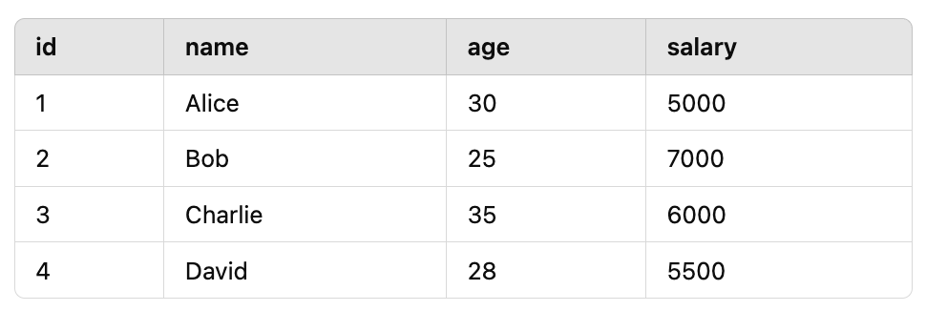
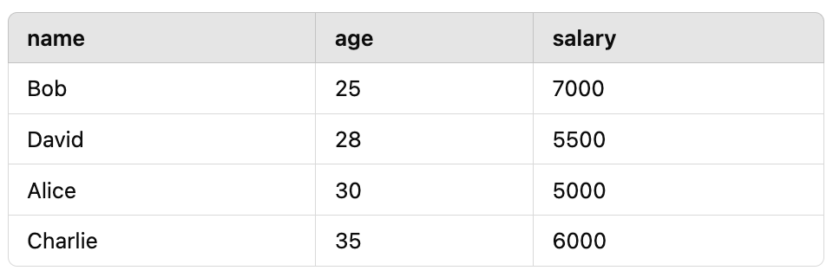

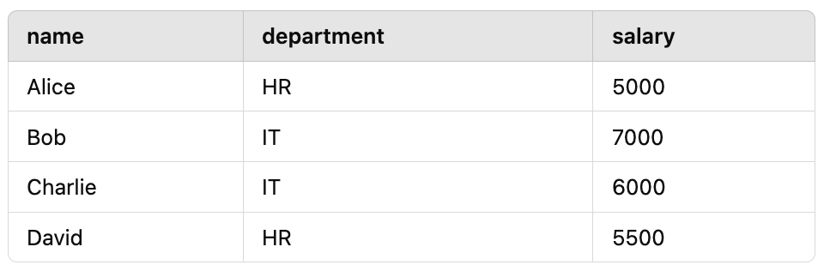
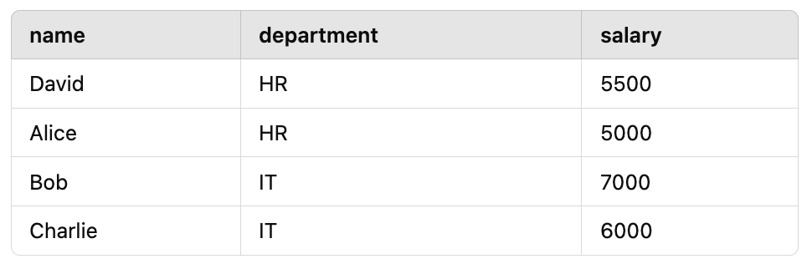
Sorting
Order By
SQL provides the ORDER BY clause to sort query results based on one or more columns.
SELECT name, age, salary FROM employees
ORDER BY age ASC;
SELECT name, department, salary FROM employees
ORDER BY department ASC, salary DESC;
5

Slide 21
SORTING NULL???
5

Slide 22
Filtering
Where Statement
SQL allows us to filter data to retrieve only relevant information. The WHERE clause is the primary tool for filtering results in SQL queries.
1/ Basic Filtering
Example: Get all employees with a salary greater than 50,000?
SQL:
SELECT name, salary
FROM employees
WHERE salary > 50000;
2/ Filtering with Comparison Operators = != > < >= <=
3/ Filtering with Logical Operators AND OR NOT
Example: Find employees in the Sales department with a salary above 60,000?
SQL:
SELECT name, department, salary
FROM employees
WHERE department = 'Sales' AND salary > 60000;
5

Slide 23
Filtering
Where Statement
SQL allows us to filter data to retrieve only relevant information. The WHERE clause is the primary tool for filtering results in SQL queries.
1/ Filtering with Between Operators
Example: Find orders placed between '2024-01-01' and '2024-03-31'?
SQL:
SELECT order_id, order_date
FROM orders
WHERE order_date BETWEEN '2024-01-01' AND '2024-03-31';
2/ Filtering with In Operator
Example: Find all employees in the Marketing or HR departments?
SQL:
SELECT name, department
FROM employees
WHERE department IN ('Marketing', 'HR');
3/ Filtering with LIKE for Pattern Matching
Example: Find customers whose names start with "J"?
SQL:
SELECT name
FROM customers
WHERE name LIKE 'J%';
5

Slide 24
Working with SQL Server Database / BigQuery
Handling error messages
Practice time
3

Slide 25

fullstackdatascience.com
References
https://docs.teradata.com/
https://cloud.google.com/bigquery/docs
https://learn.microsoft.com/en-us/azure/azure-sql/?view=azuresql
https://www.postgresql.org/docs/
https://dev.mysql.com/doc/
https://www.youtube.com/watch?v=TvLWozM182E&t=1481s
11

Slide 26





Thank you
096 574 90 25
CREATED BY
Nguyen Tien Huy
info@robusto.ai
fullstackdatascience
huynt@fullstackdatascience.com
Data Manager
https://fullstackdatascience.com/
Hanoi, Vietnam

